Slide 1
Lending Club
Erik Burd
Digital Assembly, DS-SF-24, August 16, 2016

Slide 2
Agenda
Project Goal & Background
Methods & Results
Other Techniques Attempted
Conclusion

Slide 3
Project Goal & Background
Goal: Using loan data from Q1 2016, predict whether or not a loan will become delinquent
Definition of delinquent for the project: Current loan status is not “Current” or “Fully Paid”
Delinquent - Being late on a payment that's due http://www.investopedia.com/terms/d/delinquent.asp

Slide 4
Exploratory Analysis of Data
114 variables, with 134,000 observations
Data was relatively clean
Many variables had missing values or very sparse, not useable for project
Approximately 1450 observations indicated being in default (1.1%)
Used the data dictionary to determine which variables to use https://resources.lendingclub.com/LCDataDictionary.xlsx

Slide 5
Methods - Data cleaning
Data set for project: 17 variables selected from data dictionary
Some variables used in the initial model:
Income
Debt to Income Ratio
Interest Rate
Loan Amount
Months Since Last Delinquency
Loan Term in Months
Total Current Balance

Slide 6
Method #1 – Logistic regression (1 of 2)
Logistic Regression
Used 7 variables for model, eliminating variables not contributing to model
Required multiple passes to determine which variables to use
Cross-Validation
Accuracy = .989535 (excellent for prediction)
Interpretability – not so good; no positive predictions in confusion matrices
[ 0 123622]
[ 0 1320 ]
Notes:
TP FN
FP TN

Slide 7
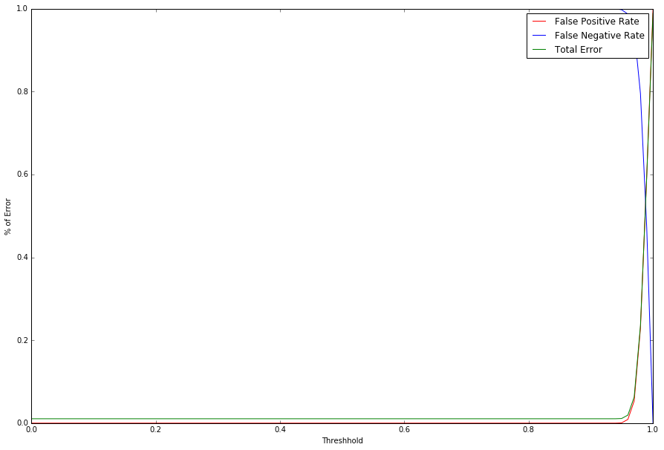
Method #1 – logistic regression (2 of 2)
Threshold = 0.995
Confusion matrix
[ 865 455]
[87759 35863]
Could the threshold be reduced?
Notes:
TP FN
FP TN

Slide 8
Method #2 – sampling data (1 of 2)
Sampled the data (6300 observations, 25% delinquent, 75% non-delinquent)
Logistic regression
Used same 7 variables in previous experiment
Cross-validation score of .779, still no positive predictions
[ 0 1320]
[ 0 4653]
Notes:
Randomly selected 4000+ rows using Excel; all delinquent loans included in the data set
TP FN
FP TN

Slide 9
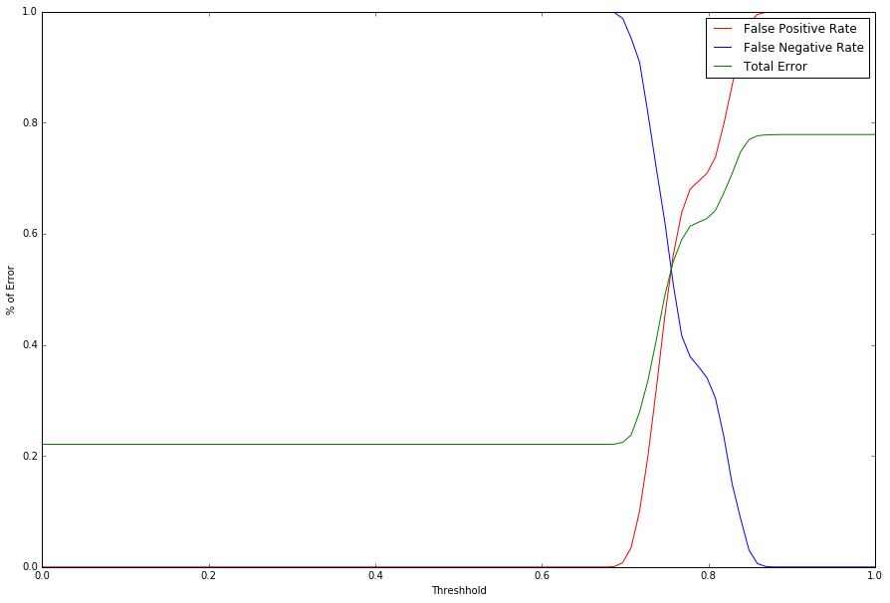
Method #2 – sampling data (2 of 2)
Threshold slightly better - .795
Confusion matrix was the same for True Positive and False Negative
[ 865 455]
[3281 1372]
Notes:
TP FN
FP TN

Slide 10
Method #3 – Log transform (1 of 2)
Used a Log₁₀ transform on 2 variables to normalize them
Income
Total current balance
Eliminated 2 additional variables from model, now using 5 variables
Cross-validation of .783, slight improvement on confusion matrices
[ 24 1244]
[ 16 4542]
Notes:
Hamed suggested using Log10 transform; Income. Max Total Balance and Total Current balance were highly skewed to the left
TP FN
FP TN

Slide 11
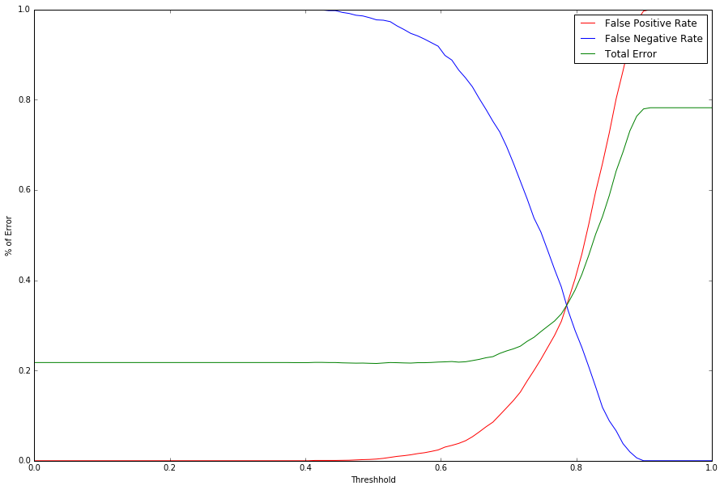
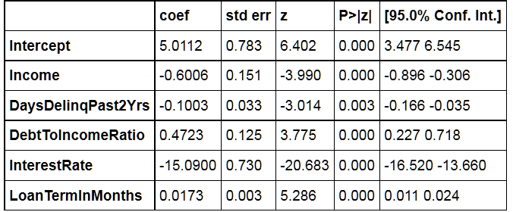
Method #3 – log transform (2 of 2)
Threshold is the same as before - .795
Confusion matrix slightly better
[ 883 385]
[1766 2792]
Each unit increase in income will reduce the chance of default by 60% (logarithmic)
Notes:
Values for coefficients are %’s; each unit of income reduced chance of default by 60%
TP FN
FP TN

Slide 12
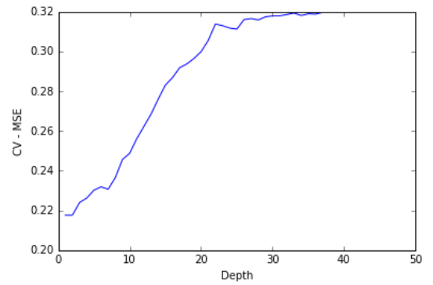
Other techniques (1 of 3)
Decision Trees
Used all 17 original variables
MSE = .21, Depth = 1
Only one feature chosen - Interest Rate

Slide 13
Other techniques (2 of 3)
Random Forest Classifier
Used all 17 original variables
Interest Rate was the most important variable
OOB Score = .7826
Importance | Variable
0.2664 | Interest Rate
0.1270 | MaxCurBalance
0.1135 | DebtToIncomeRatio
0.1084 | TotalCurBalance
0.1025 | Income
0.0878 | LoanAmt
0.0549 | MonthsSinceLastDelinq
0.0464 | YrsEmployed
0.0264 | MonthsSince90DayWarning
0.0254 | MonthsSinceBankcardDelinq
0.0136 | DaysDelinqPast2Yrs
0.0125 | LoanTermInMonths
0.0098 | NumAcctsEver120DaysDue
0.0050 | NumPublicRecordBankruptcies
0.0002 | Accts30DaysPastDue
0.0001 | DelinqCurAmt
0.0000 | Accts120DaysPastDue
Notes:
10,000 trees, max features = 14
Max Current Balance – Max balance on all revolving accounts
Total Current Balance – Total balance on all accounts (including revolving)

Slide 14
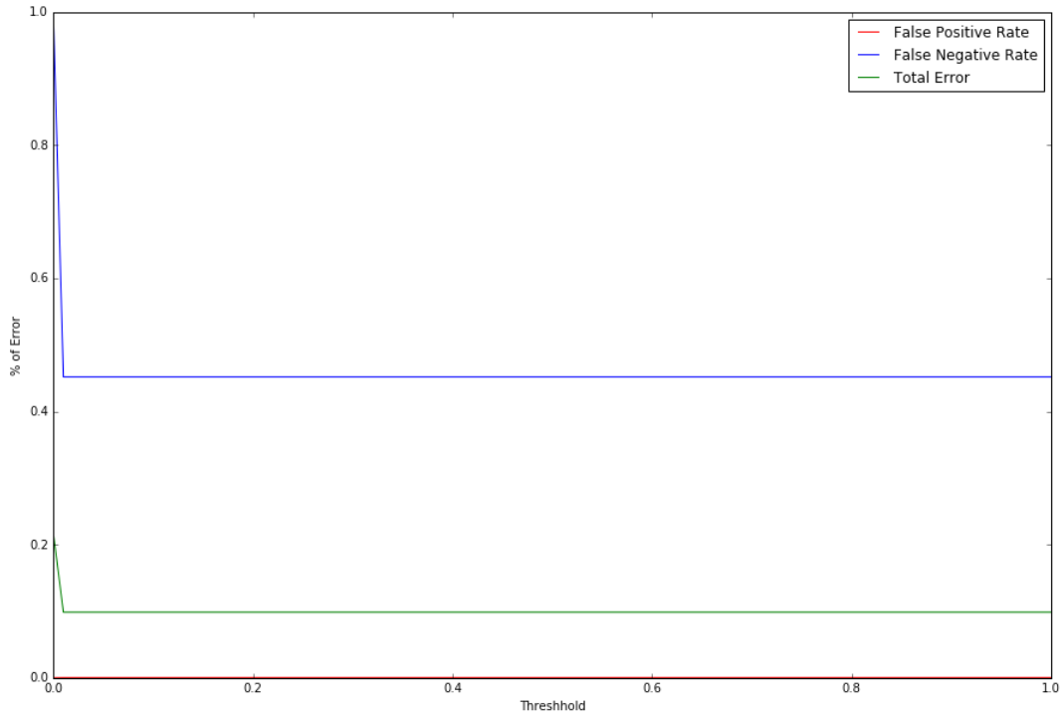
Other techniques (3 of 3)
Threshold is now much better = 0.02
Confusion matrix
[ 695 573]
[ 0 4558]
No false positives, now have true positives and true negatives.
Notes:
TP FN
FP TN

Slide 15
conclusion
Random forest model seems to do a reasonable job of modeling the data
Most important variables
Interest rate
Max Current Balance
Debt to Income Ratio
Required additional tuning
Determining threshold, sampling, data transformation
Considerations
More data for further analysis
Try other techniques
Gabriel_ForestFire_Final.ipynb

